Slide 1

BUG
TRACKING
SYSTEM
Presentation By :
STAR TECHIES
HTI Strikers - 2021

Slide 2
Abstract
A bug is the consequence/outcome of a coding fault. A bug tracking system is a software application that keeps track of reported software bugs in software development projects. The main benefit of a bug-tracking system is to provide a clear centralized overview of development requests including both bugs and improvements and their state. Also, it automates the process of monitoring and tracking bugs and other issues that may hamper the efficient performance of a company’s technology and information infrastructure. Using this application effectively a team will be able to deliver high-quality products, improve customer satisfaction and the cost of product development will also be lowered.

Slide 3
Agenda
Introduction
Scope of the project
Hardware and Software Requirements
Architecture
UML Diagrams
Modules
Implementation
Output Snippets
Test Cases
Future Scope
Conclusion
References

Slide 4
Introduction
Bug Tracking System is an online web-based application that is designed to help quality assurance by keeping the track of bugs for projects.
This application allows software testers to report bugs for a project , project managers to view all the bugs as well as assign bugs to developers and developers to update the bug status.

Slide 5
Scope of the Project
The Bug Tracking System can be used by the Project Managers, Testers and Developers of an organization to improve speed, efficiency and collaboration. Thus, enforcing quality assurance and performance tracking.
This bug tracking system can effectively manage and store information related to the project and the team members giving an insight into the next set of actions or bugs which need to be resolved. It is easy to use by everyone and is low cost

Slide 6
Requirements Specification
Hardware Requirements
Processor : Intel Core i3 and above
OS : Windows 10
Memory(RAM) : 4 GB
Storage : 50 GB and more
Software Requirements
User Interface : JSP, CSS, Bootstrap
Client-side Scripting : JavaScript
Programming Language : Java
Web Applications : JDBC, Servlets, JSP
Database : MySQL
IDE/ Workbench : Spring Tools Suite, Visual Studio Code
Server : Apache Tomcat 8.5

Slide 7
Layered Architecture
User interaction layer
Functionality layer
Business rules layer
Application core layer
Database layer

Slide 8
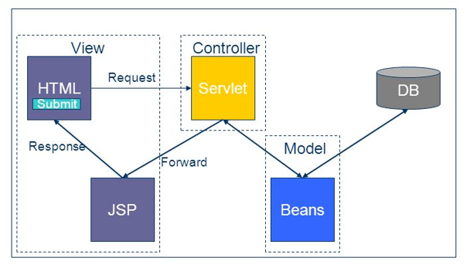
MVC Architecture

Slide 9
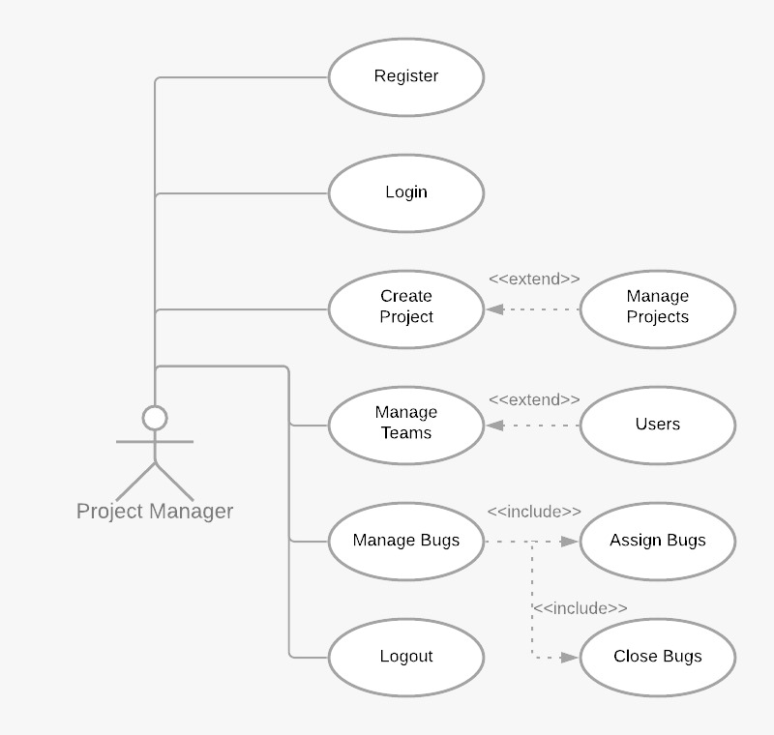
UML Diagrams
Use Case Diagram

Slide 10
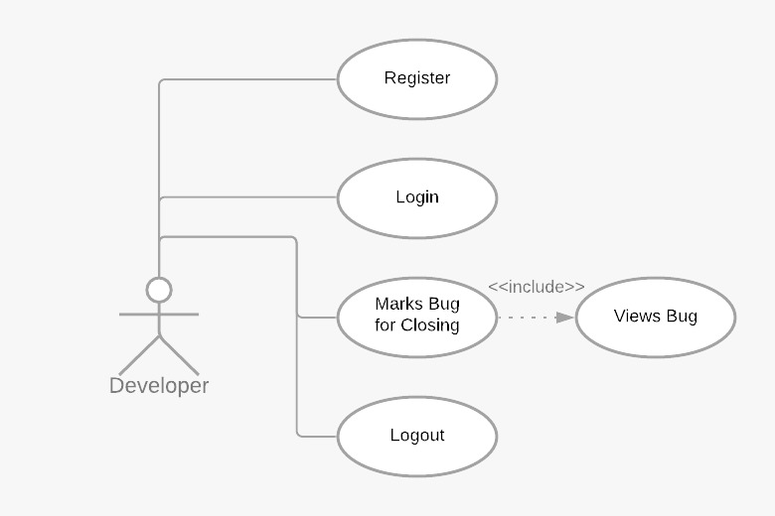
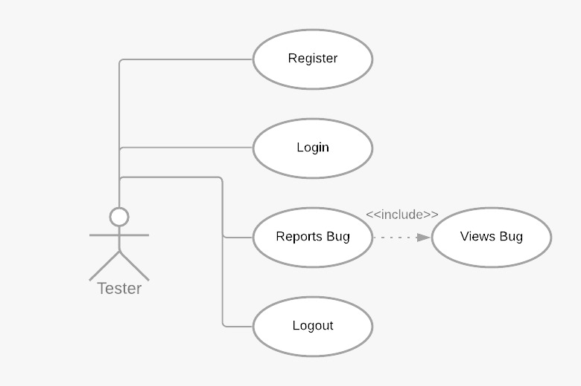
UML Diagrams

Slide 11
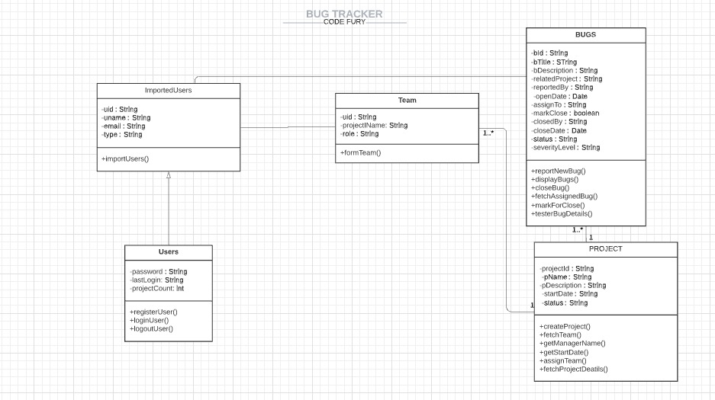
UML Diagrams
Class Diagram

Slide 12

Modules
01
Import Users
06
Tester
02
05
User Registration
Developer
03
Login
04
Project manager

Slide 13
Modules
Import Users
This module provides a form to import a JSON/ XML file containing user information into the system
Registration
This module allows a user that has been imported to register with the system and generate a password
Login
This module allows a user to login who has been registered

Slide 14
Modules
Project Manager
Create a new project and manages the projects
Assign team members to a project
Views all the bugs and assigns the bugs to the developers and closes the bugs
Tester
Views the list of projects
Views the list the bugs assigned to each project by the project manager
Reports a new bug
Developer
Views the details of the project which is assigned
Mark a bug for closing

Slide 15
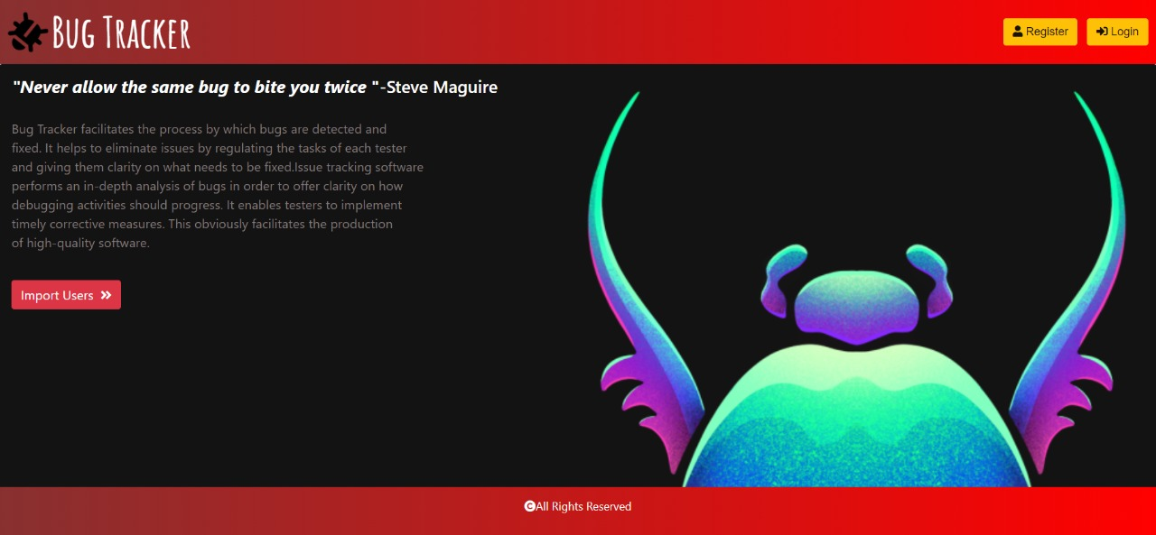
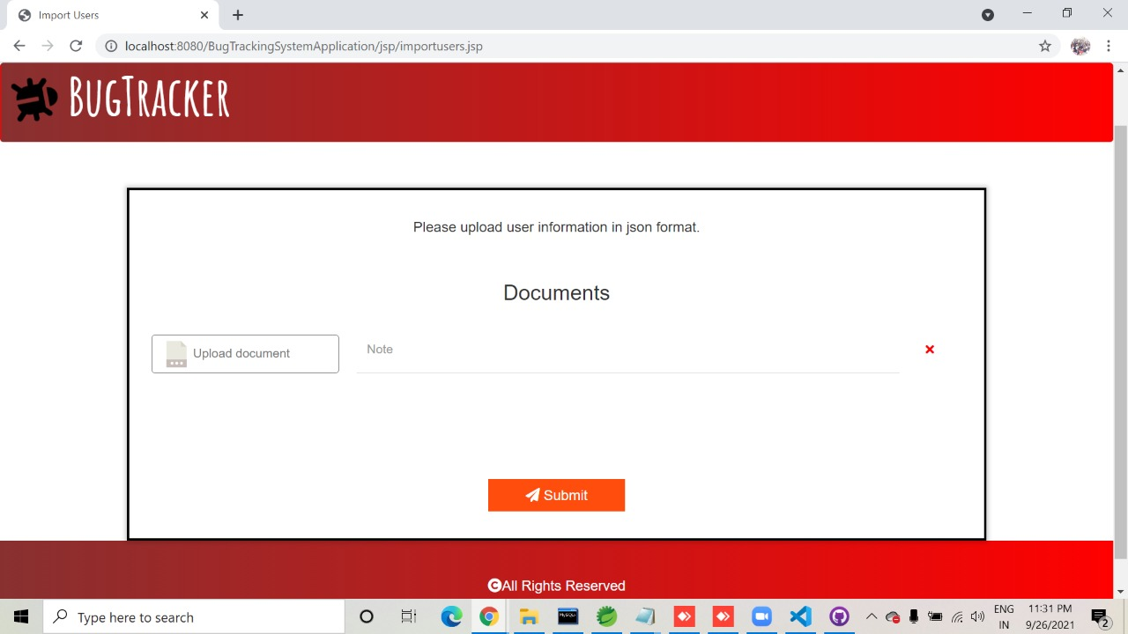
Output Snippets

Slide 16
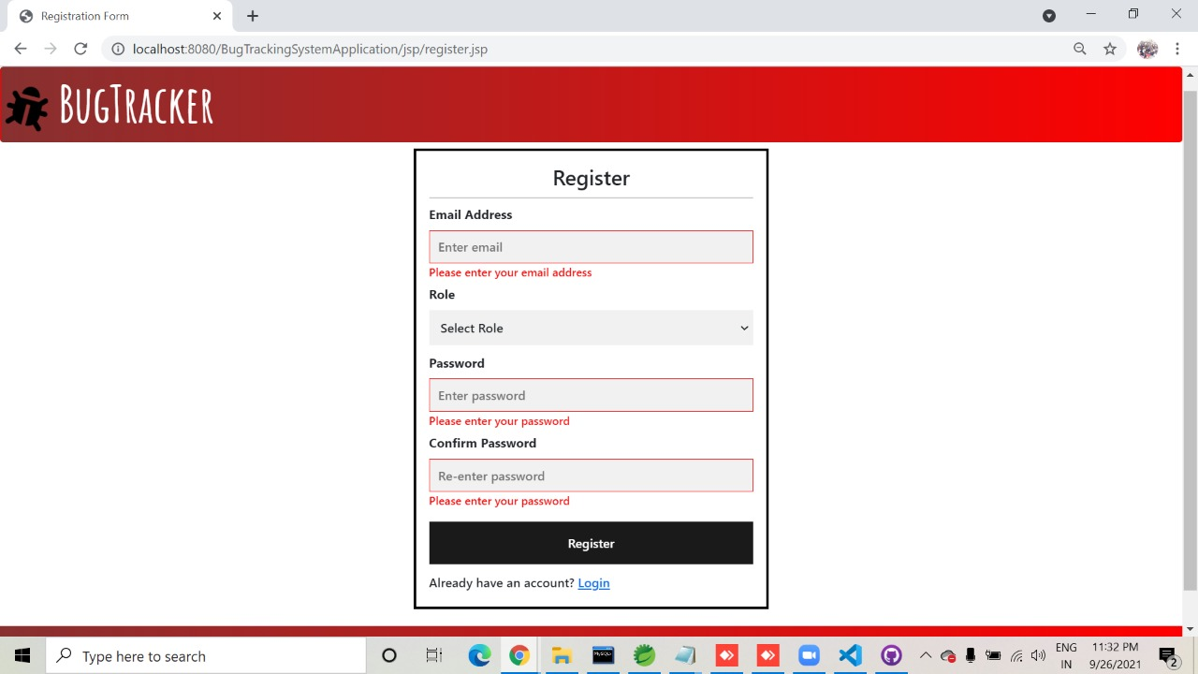
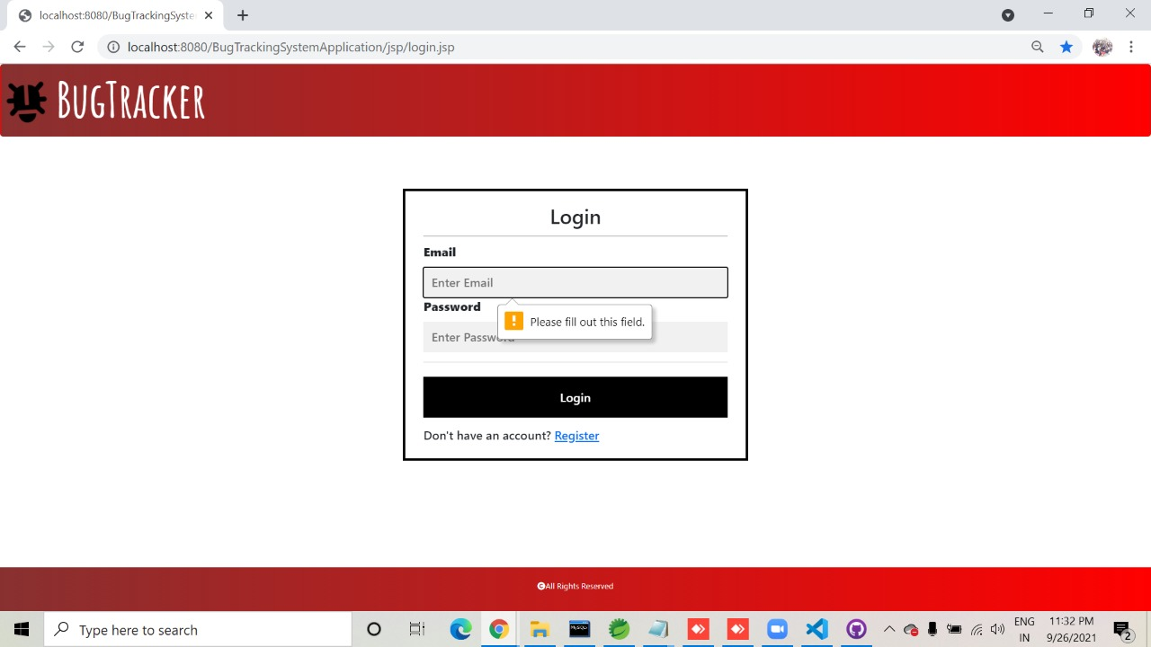
Output Snippets

Slide 17
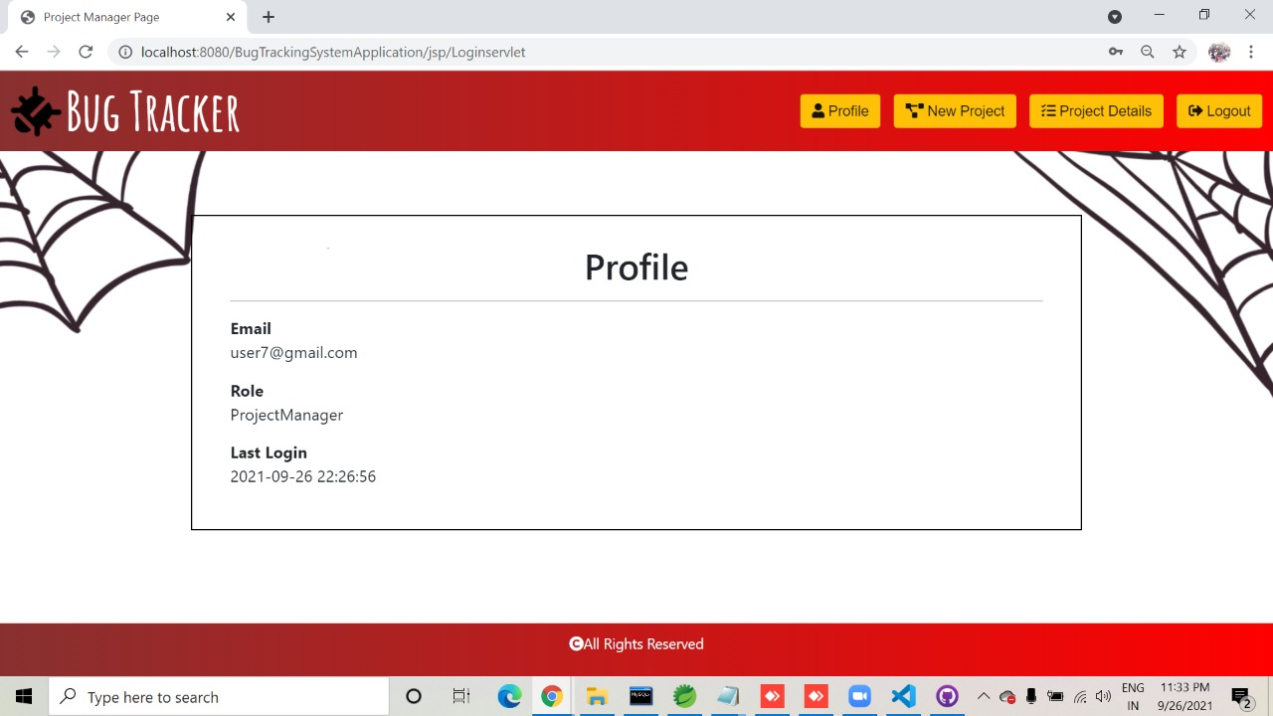
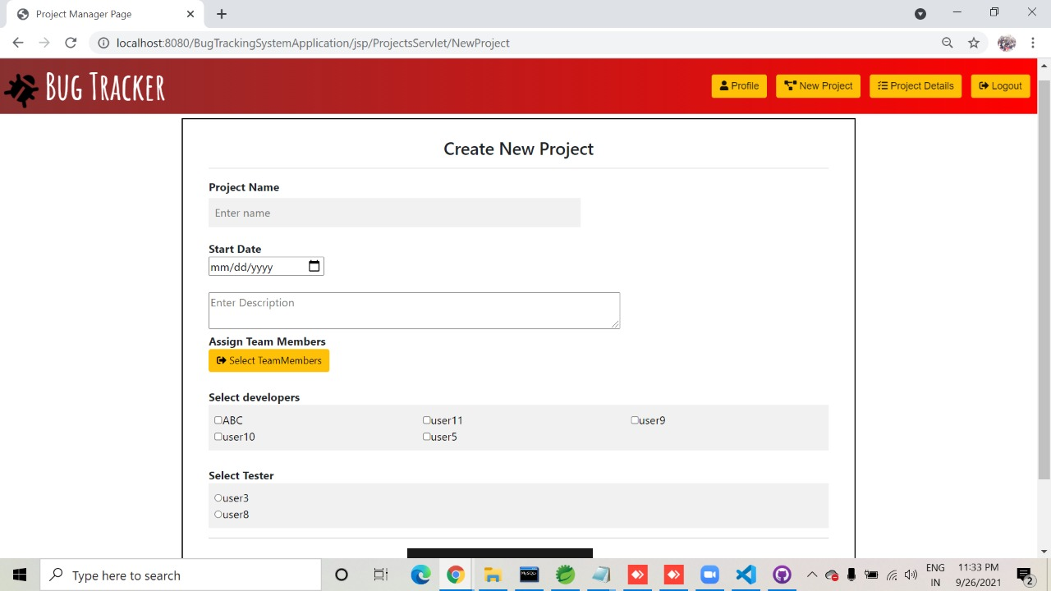
Output Snippets

Slide 18
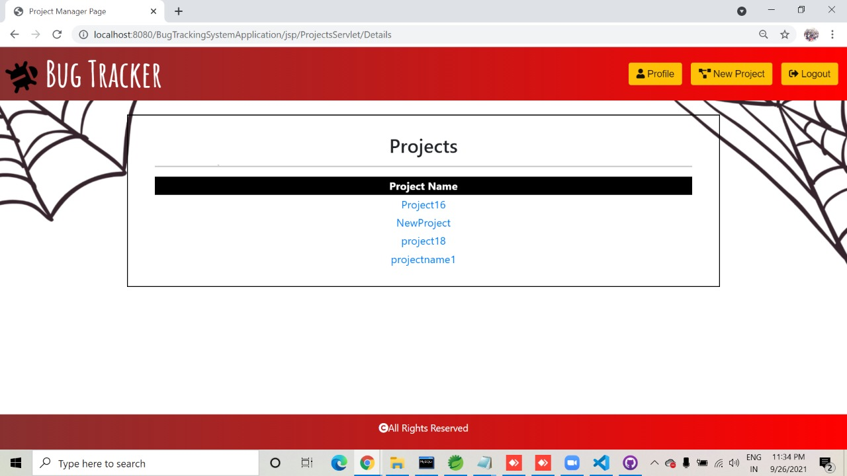
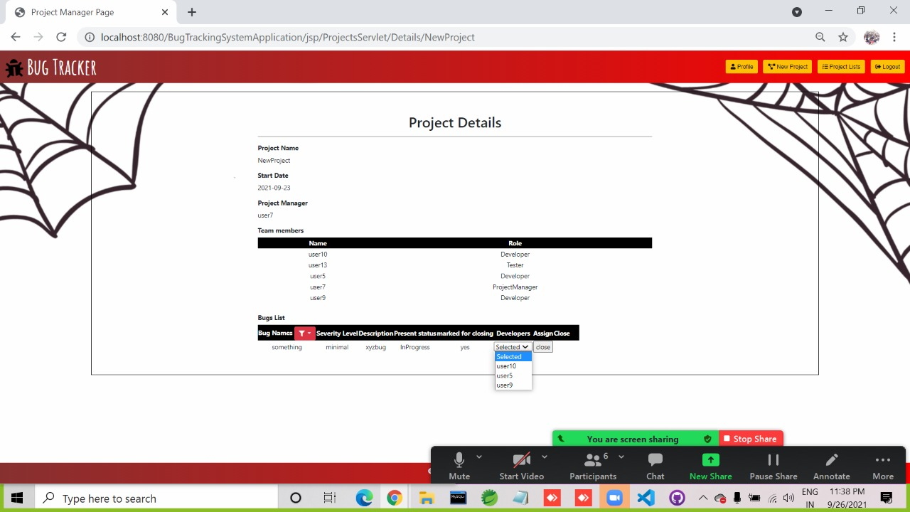
Output Snippets

Slide 19
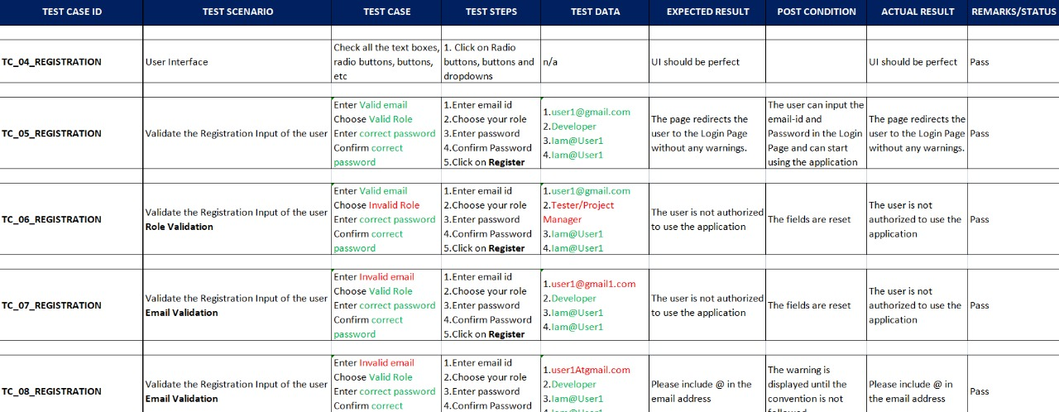
Test Cases
For Registration page

Slide 20
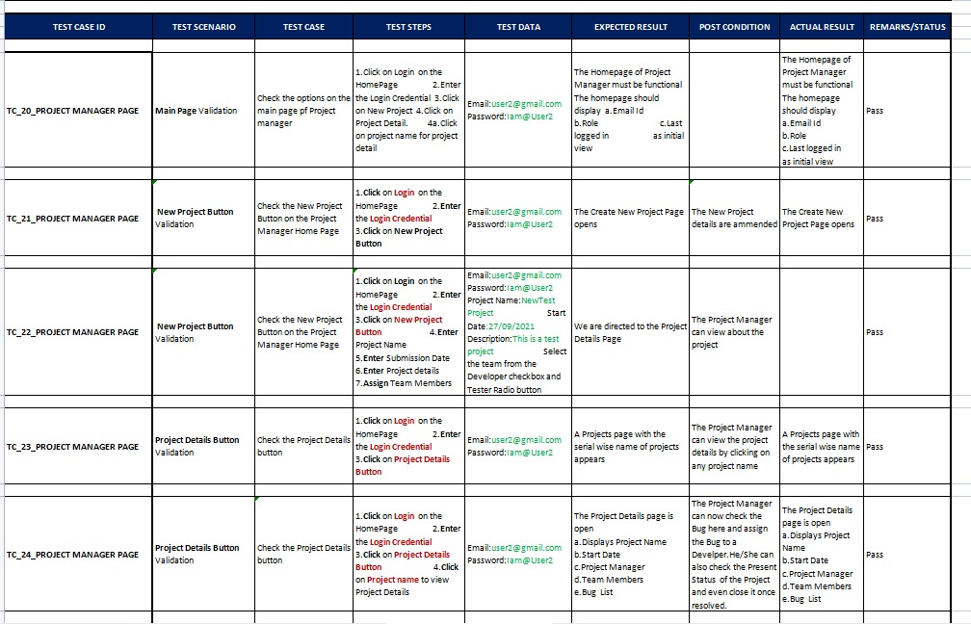
Output Snippets
For Create New Project page

Slide 21
Future Scope
Current bug tracking systems do not effectively elicit all of the information needed by developers. Without this information developers cannot resolve bugs in a timely fashion and so we believe that improvement to the way bug tracking systems collect information are needed.
In the future, we will move from the current prototype of the interactive system to a full-scale system that can deal with a variety of information to gather, as commonly observed in the real world.

Slide 22
Conclusion
A software bug occurs when an application or program doesn’t work the way it is designed to function. Most errors are faults or mistakes made by system architects, designers or developers. Testing teams use bug tracking to monitor and report on errors that occur as an application is developed and tested. The proposed Bug Tracking system is a great application with software development needs. By using the Bug Tracking Software one can eliminate bugs in their project effectively as it contains all the necessary information required by the developers to resolve the issue. This application will definitely increase communication between the team members and improve customer satisfaction and efficiency.

Slide 23
References
https://www.google.com/
https://stackoverflow.com/
https://projectsgeek.com/2016/02/bug-tracking-system-java-project.html
https://www.tutorialspoint.com/servlets/
https://www.codejava.net/java-ee/jsp/
https://www.w3schools.com/java/
https://www.geeksforgeeks.org/java/

Slide 24
Team Collaboration
Raga Rasagna P
Gautami S Nair
Anindya Singhmar
Gaurav Pandey
Chaitanya Ashtekar
Vandana Bora
Lokinendi Sai Harshita
Anuraag Ajaykummar
Mounika Kalakonda
Avirupa Saha

Slide 25

THANK YOU

